Slide 1
INVESTMENT CASE STUDY SUBMISSION
T.M.Dinesh Krishna

Slide 2
<Abstract>
The Spark Funds wants to understand the global trends in investments so that she can take the investment decisions effectively and make investments in a few companies.
The objective is to identify the best sectors, countries, and a suitable investment/funding type for making investments
Spark Funds has two minor constraints for investments:
• It wants to invest between 5 to 15 million USD per round of investment
• It wants to invest only in English-speaking countries because of the ease of communication with the companies it would invest in

Slide 4
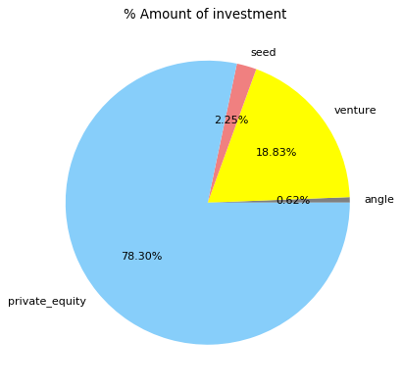
% of Investment on various funding types

Slide 5
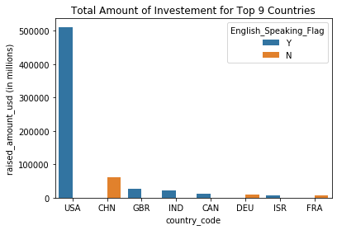
Top 9 countries investment

Slide 6
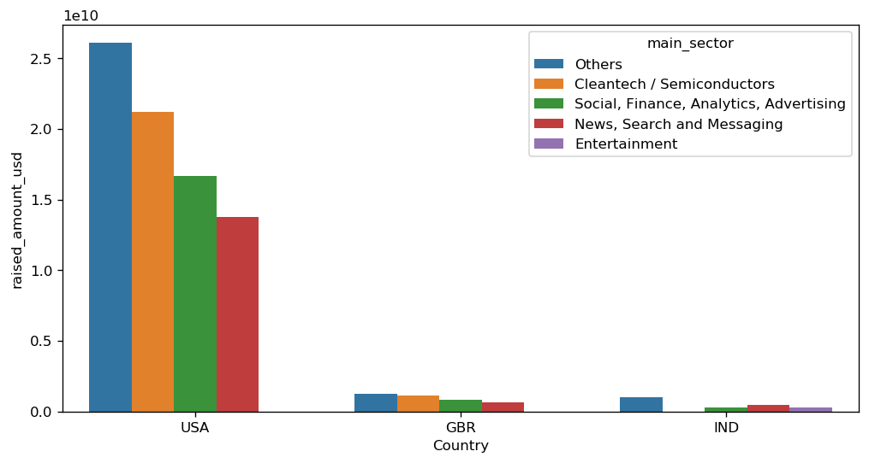
Top 3 countries investment sector wise

Slide 7
<Conclusions>
Based on the data it was clear that USA is the best place for the investment .
After USA , GBR and IND has a good option .
Also could see investment in below sector across the countries is best opt for the spark funds.
1, Cleantech / Semiconductors
2, Social, Finance, Analytics, Advertising
4, News, Search and Messaging
5, Entertainment

